Slide 1

Microsoft Azure
Brief Overview and Creation of Test Website
Notes:
introduction

Slide 2

What is Microsoft Azure?

Slide 3
From Official Website
“Azure is Microsoft’s cloud computing platform, a growing collection of integrated services - analytics, computing, database, mobile, networking, storage, and web - for moving faster, achieving more, and saving money.”
http://azure.microsoft.com/
Notes:
Добавить рамку

Slide 4
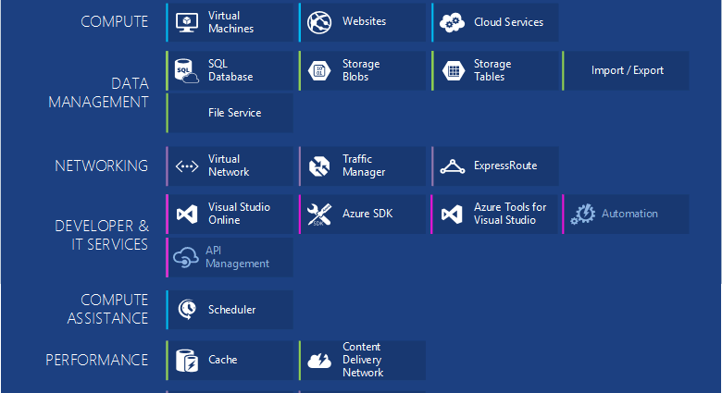
Azure Components
Notes:
https://azure.microsoft.com/en-us/documentation/articles/fundamentals-introduction-to-azure/
Icons:
https://www.amido.com/azure-icons-for-lucidchart/

Slide 5
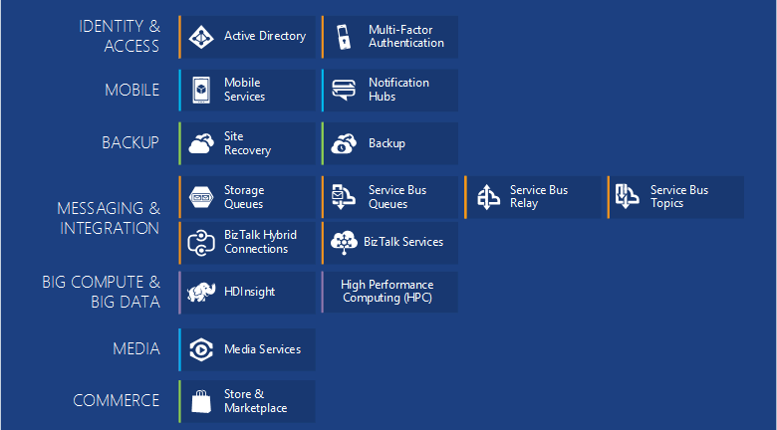
More Azure Components
Notes:
https://azure.microsoft.com/en-us/documentation/articles/fundamentals-introduction-to-azure/

Slide 6






Cloud Solutions
War of Attrition
Notes:
Slides “Windows Azure vs. Amazon AWS”:
http://www.slideshare.net/tekcraft/azure-vsamazon?related=1
https://image.slidesharecdn.com/warofattritioninfographicv1-150103195155-conversion-gate02/95/war-of-attrition-aws-vs-google-ibm-and-microsoft-azure-1-638.jpg?cb=1424632280

Slide 7
Public Cloud Usage 2015
Notes:
Information from:
http://assets.rightscale.com/uploads/pdfs/RightScale-2015-State-of-the-Cloud-Report.pdf
http://www.rightscale.com/blog/cloud-industry-insights/cloud-computing-trends-2015-state-cloud-survey
In private cloud leading VMware
In January 2015, RightScale conducted its fourth annual State of the Cloud Survey of the latest cloud computing trends, with a focus on infrastructure-as-a-service. The survey asked 930 IT professionals about their adoption of cloud infrastructure and related technologies. The respondents ranged from technical executives to managers and practitioners and represented organizations of varying sizes across many industries. The margin of error is 3.2 percent.

Slide 8
Public Cloud Usage 2015 vs. 2014
Notes:
In private cloud leading VMware

Slide 9
2014 Statistics
Notes:
https://image.slidesharecdn.com/warofattritioninfographicv1-150103195155-conversion-gate02/95/war-of-attrition-aws-vs-google-ibm-and-microsoft-azure-1-638.jpg?cb=1424632280
DEFINITION of 'Free Cash Flow - FCF'
A measure of financial performance calculated as operating cash flow minus capital expenditures. Free cash flow (FCF) represents the cash that a company is able to generate after laying out the money required to maintain or expand its asset base. Free cash flow is important because it allows a company to pursue opportunities that enhance shareholder value. Without cash, it's tough to develop new products, make acquisitions, pay dividends and reduce debt. FCF is calculated as:EBIT(1-Tax Rate) + Depreciation & Amortization - Change in Net Working Capital - Capital ExpenditureIt can also be calculated by taking operating cash flow and subtracting capital expenditures.
Read more: http://www.investopedia.com/terms/f/freecashflow.asp#ixzz3crRZ0U2k Follow us: @Investopedia on Twitter

Slide 10
Payments
Notes:
App Service Pricing:
http://azure.microsoft.com/en-us/pricing/details/app-service/

Slide 11

Azure Geography
Azure operates out of 17 regions around the world
Notes:
http://azure.microsoft.co
AZURE REGION LOCATION
Central US Iowa
East US Virginia
East US 2 Virginia
US Gov Iowa Iowa
US Gov Virginia Virginia
North Central US Illinois
South Central US Texas
West US California
North Europe Ireland
West Europe Netherlands
East Asia Hong Kong
Southeast Asia Singapore
Japan East Tokyo, Saitama
Japan West Osaka
Brazil South Sao Paulo State
Australia East New South Wales
Australia Southeast Victoriam/en-us/regions/

Slide 12
Cloud Service Models
Managed by Customer
Managed by Vendor
Private
(On-Premises)
Infrastructure
(as a Service)
Platform
(as a Service)
Software
(as a Service)
Applications
Applications
Applications
Applications
Data
Data
Data
Data
Runtime
Runtime
Runtime
Runtime
Middleware
Middleware
Middleware
Middleware
O/S
O/S
O/S
O/S
Virtualization
Virtualization
Virtualization
Virtualization
Server
Server
Server
Server
Storage
Storage
Storage
Storage
Networking
Networking
Networking
Networking
Notes:
Windows Azure IaaS vs. PaaS vs. SaaS
http://robertgreiner.com/2014/03/windows-azure-iaas-paas-saas-overview/
Which Windows Azure Cloud Architecture? PaaS or IaaS ?
http://blogs.msdn.com/b/hanuk/archive/2013/12/03/which-windows-azure-cloud-architecture-paas-or-iaas.aspx

Slide 13

Cloud Service Models and Azure
IaaS
Virtual Machines
SaaS
PaaS
Cloud Services
SQL Azure
Storage Tables
Storage Blobs
Cache
Traffic Manager
Mobile Services
Notes:
Windows Azure IaaS vs. PaaS vs. SaaS
http://robertgreiner.com/2014/03/windows-azure-iaas-paas-saas-overview/
IaaS: VM
PaaS: CloudServices, WebSites, SQL Azure
SaaS: WebSites (Drupal, Jumla), SharePoint,
Icons:
https://www.amido.com/azure-icons-for-lucidchart/

Slide 14
Azure IaaS vs PaaS Statistics

Slide 15

From Words to Deeds
Notes:
https://portal.azure.com
https://manage.windowsazure.com

Slide 16
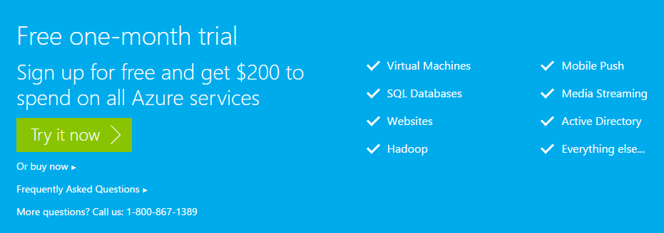
How to Try (Free Trial)
Screenshot
Notes:
Free one-month trial
http://azure.microsoft.com/en-us/pricing/free-trial/

Slide 17
How to Manage
From Visual Studio with Azure SDK
From Management Portals:
https://manage.windowsazure.com
https://portal.azure.com (beta)
Using PowerShell Console
Notes:
How to install and configure Azure PowerShell:
https://azure.microsoft.com/en-us/documentation/articles/powershell-install-configure/

Slide 18
Azure SDK and Command-line Tools
The Azure SDK for .NET is the core building block that helps developers author Cloud Services using Azure Service Runtime Programming model, debug using emulators on the local machine, and deploy to Azure data centers in the cloud.
The Azure SDK Policy covers Azure SDK Authoring Tools, Command line utilities, Compute & Storage Emulators, and Azure Tools for Microsoft Visual Studio.
Notes:
Downloads:
http://azure.microsoft.com/en-us/downloads/
Main data from:
https://msdn.microsoft.com/en-us/library/azure/dn479282.aspx
How to install and configure Azure PowerShell
https://azure.microsoft.com/en-us/documentation/articles/powershell-install-configure/

Slide 19

App Service (Web App)
Notes:
Link to Icon:
https://github.com/amido/azure-vector-icons/blob/master/icons/Web%20Sites.svg

Slide 20
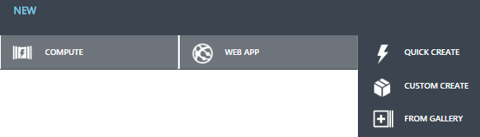

Create App Service
Screenshot
From Management Portals
From Visual Studio Interface
Using PowerShell Console
Screenshot
Notes:
How could be created?

Slide 21
Create App Service from PowerShell
Code Snippet
$AzureSubscriptionId = "Some_Azure_Subscription_Id"
Import-AzurePublishSettingsFile “**\*.publishsettings"
Set-AzureSubscription –SubscriptionId $ AzureSubscriptionId
$AzureTestWebSite = "workshop-created-from-ps"
New-AzureWebsite $ AzureTestWebSite
Get-AzureWebsite -Name $ AzureTestWebSite
Stop-AzureWebsite -Name $ AzureTestWebSite
Get-AzureWebsite -Name $ AzureTestWebSite
Remove-AzureWebsite -Name $ AzureTestWebSite
Get-AzureWebsite
CreateWebSite.ps1
Notes:
How to install and configure Azure PowerShell
https://azure.microsoft.com/en-us/documentation/articles/powershell-install-configure/
Clear-AzureProfile before the Add-AzureAccount
http://blogs.msdn.com/b/devfish/archive/2015/02/12/get-azurevm-your-azure-credentials-have-not-been-set-up-or-have-expired-please-run-add-azureaccount-to-set-up-your-azure-credentials.aspx
Add-AzureAccount
https://msdn.microsoft.com/en-us/library/dn495128.aspx
New-AzureWebsite
https://msdn.microsoft.com/en-us/library/azure/dn495157.aspx

Slide 22
Deploy a Web App
Deploy from a cloud-hosted source control system
Deploying from an IDE
Deploy using an FTP utility
Deploying from an on-premises source control system
Deploy using command-line tools and the Azure REST management API
Octopus Deploy
Notes:
Deploy a web app in Azure App Service
https://azure.microsoft.com/en-us/documentation/articles/web-sites-deploy/

Slide 23

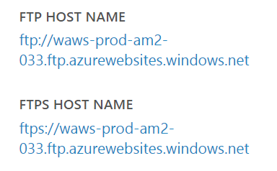
FTP Access
Just create FTP credentials and use provided on Management Portal access points
Screenshots

Slide 24
Secure a web app in Azure App Service
Secure communications (HTTPS)
Secure development
Publishing profiles and publish settings
Configuration settings, and connection strings
SFTP
Notes:
Show on Azure Portal
Secure a web app in Azure App Service
https://azure.microsoft.com/en-us/documentation/articles/web-sites-security/
Secure communications
If you use the .azurewebsites.net domain name created for your web app, you can immediately use HTTPS, as an SSL certificate is provided for all **.azurewebsites.net** domain names. If your site uses a custom domain name, you can upload an SSL certificate to enable HTTPS for the custom domain.
Publishing profiles and publish settings
When developing applications, performing management tasks, or automating tasks using utilities such as Visual Studio, Web Matrix, Azure PowerShell or the Azure Command-Line Interface (Azure CLI), you can use either a publish settings file or a publishing profile. Both authenticate you to Azure, and should be secured to prevent unauthorized access.
Configuration settings, and connection strings
It's common practice to store connection strings, authentication credentials, and other sensitive information in configuration files. Unfortunately, these files may be exposed on your website, or checked into a public repository, exposing this information.

Slide 25
Service Plans
Notes:
https://azure.microsoft.com/en-us/documentation/articles/azure-web-sites-web-hosting-plans-in-depth-overview/

Slide 26
Pricing Tiers

Slide 27
Traffic Manager

Slide 28
Traffic Manager (Overview)
“Microsoft Azure Traffic Manager allows to control the distribution of user traffic to specified endpoints, which can include Azure cloud services, websites, and other endpoints.”
“Traffic Manager works by applying an intelligent policy engine to Domain Name System (DNS) queries for the domain names of Internet resources.”
Notes:
Traffic Manager Overview
https://azure.microsoft.com/en-us/documentation/articles/traffic-manager-overview/

Slide 29
Improve availability of critical applications
Improve responsiveness for high performing applications
Upgrade and perform service maintenance without downtime
Traffic distribution for large, complex deployments

Slide 30
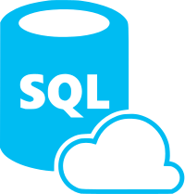
SQL Databases

Slide 31
Create Database
DATABASE THROUGHPUT UNITS
Notes:
Database Throughput Unit (DTU):
DTUs provide a way to describe the relative capacity of a performance level of Basic, Standard, and Premium databases. DTUs are based on a blended measure of CPU, memory, reads, and writes. As DTUs increase, the power offered by the performance level increases. For example, a performance level with 5 DTUs has five times more power than a performance level with 1 DTU. A maximum DTU quota applies to each server. For more information on DTU quotas, seeAzure SQL Database General Guidelines and Limitations.
DTUs provide a way to describe the relative capacity of a performance level based on a blended measure of CPU, memory, reads, and writes. Each server has a maximum of 2000 DTUs for Basic, Standard, and Premium databases, in addition to the overall limit for databases per server and maximum size per database. DTUs are consumed based on the DTU rating for that performance level. For example, a server with 5 Basic databases, 2 Standard S1 databases, and 3 Premium P1 databases consumes 365 DTUs. For more information on the DTU rating associated with each performance level, see Azure SQL Database Service Tiers and Performance Levels. An extension of this DTU quota may be available for your Azure SQL Database server. For more information, contact Azure Support.
Azure SQL Database Service Tiers and Performance Levels (Grid with details)
https://msdn.microsoft.com/en-us/library/azure/dn741336.aspx
Nice link with details about tiers:
https://azure.microsoft.com/en-us/documentation/articles/sql-database-upgrade-new-service-tiers/

Slide 32
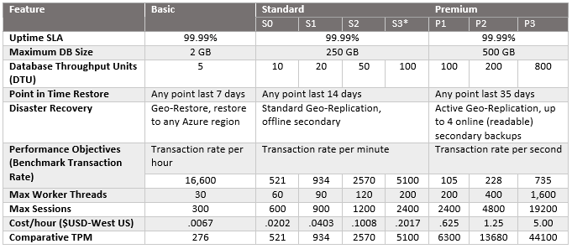
Databases Tiers
Notes:
From:
https://azure.microsoft.com/en-us/documentation/articles/sql-database-upgrade-new-service-tiers/

Slide 33
Storage

Slide 35
Tiered Migrations
Take Advantage of PaaS Where You Can
Many Applications could benefit from migrating to a mixed deployment. Migrating to web/worker roles or taking advantage of other Windows Azure services (storage, cache etc..)
Benefits of Web and Worker Roles
Simplified Deployment and Configuration
Health Model
Easy High Availability
Instance Scalability
OS Patching
Automatic Firewall Configuration
Simple Certificate Deployment
Many others

Slide 36


